Slide 1
Intro to Python
COP 4020
University of Central Florida

Slide 2
Python Section
A bit project oriented
Variables
Numbers
Text
Logic
Data Structures
Loops
Functions
Object Oriented Python

Slide 3
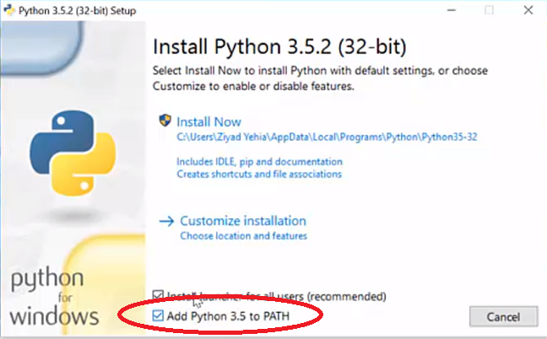
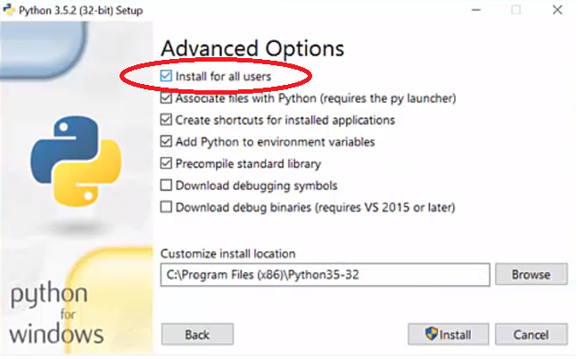
Installation
Go to https://www.python.org/downloads/
Install Python 3
Add Python to path
Use custom install and select Install for all users
Click install

Slide 4
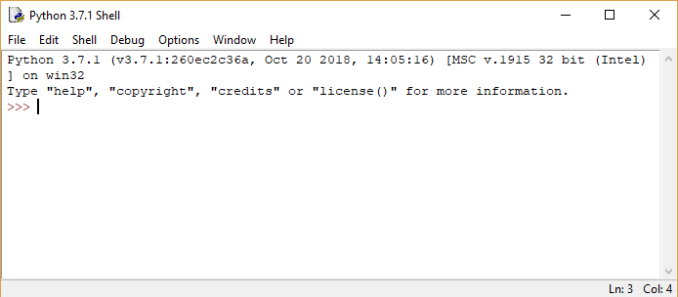
Idle
Idle is the IDE that comes with Python
To run, just type Idle

Slide 5
Simple Coding and Script Creation
File -> New
File -> Save (remember to add .py when saving)
Add code 1+1, save, and run
Go back and change code to print(1+1), save and run

Slide 6
Variables
>>> number
5
>>> name
'Rick'
number = 5
Variables are case sensitive
name = "Rick“
Or
name = ‘Rick’

Slide 7
More About Variables
Variables are dynamically typed
The type() function allows you to inspect the type of a variable
>>> type(number)
<class ‘int’>
>>> type(name)
<class 'str’>
Note: types can change

Slide 8
Null Variables
Variables can be null in python – this is different than them not existing
>>> foo = None
>>> foo is None
True

Slide 9
Variables Review
Variables are boxes that store data
Each Python variable has a name and a value
Assignment name = value
Variable types can change
The type() function can be used to get a variable’s type

Slide 10
External Source Code
Suggested to create a dedicated folder for source code. I use c:\work\Python
Use a text editor such as Notepad++ or Sublime to create a source code module with a .py extension
Go to File\Open to open and load external source code

Slide 11
Variables Continued
As expected:
firstNumber = 1 + 2
secondNumber = 105 + 10
print(firstNumber)
print(secondNumber)

Slide 12
Variable Expressions
You can perform normal operations with variables
total = firstNumber + secondNumber
print(total)

Slide 13
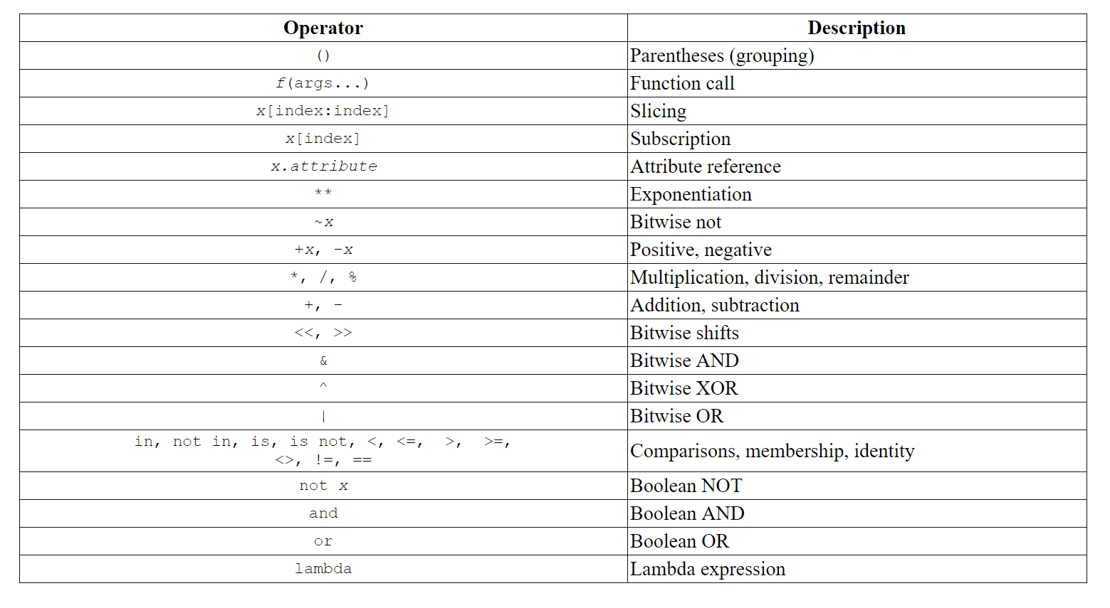

Slide 14
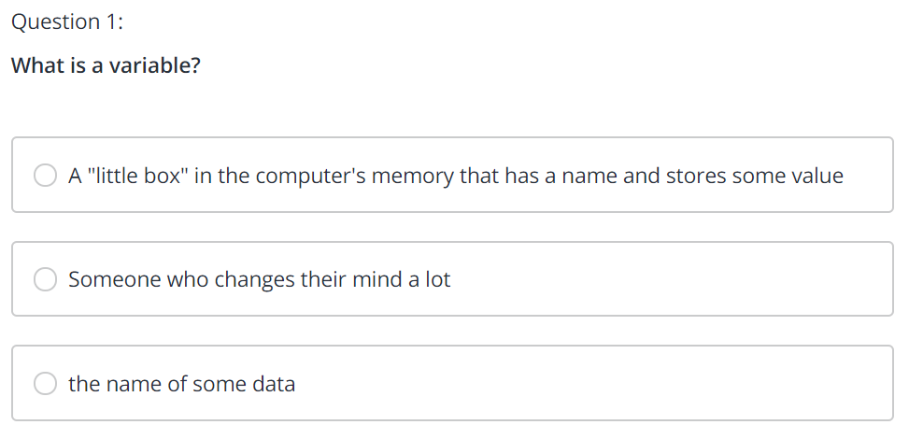

Slide 15
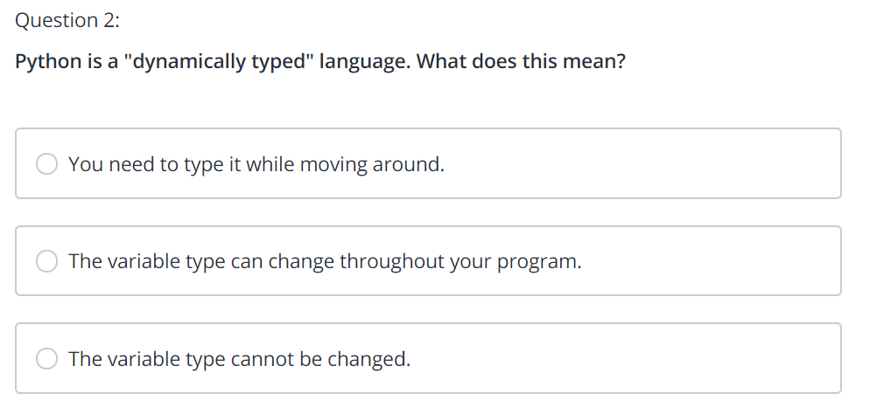

Slide 16
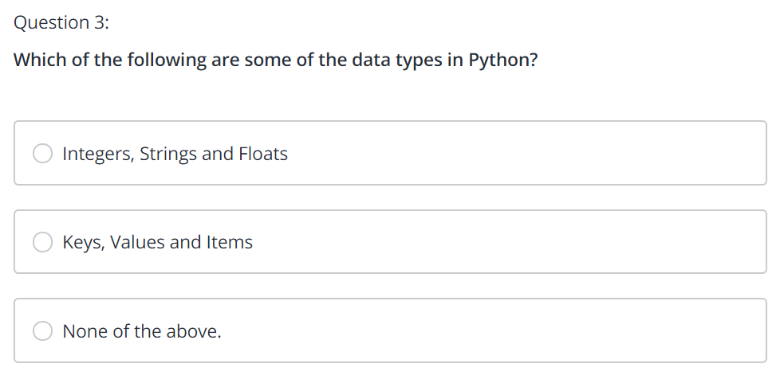

Slide 17
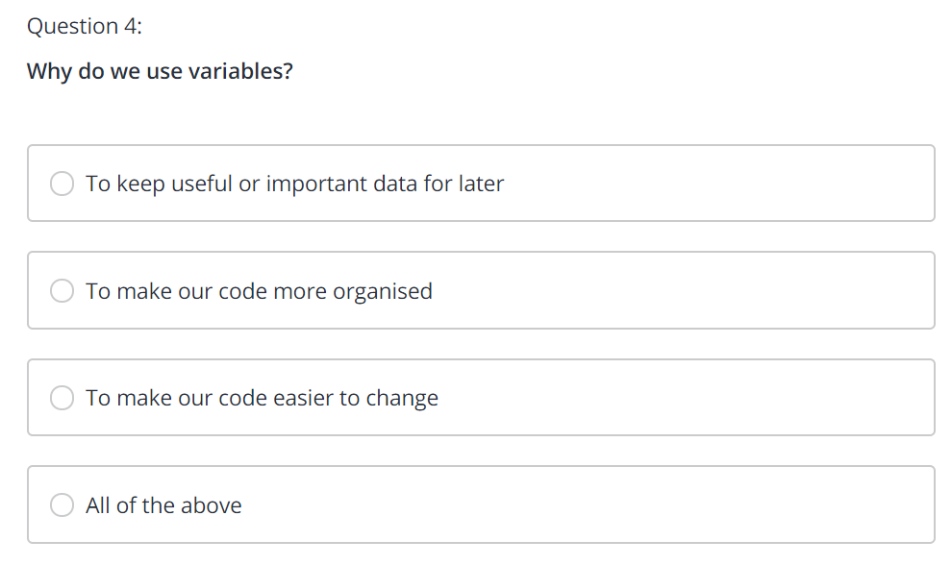

Slide 18
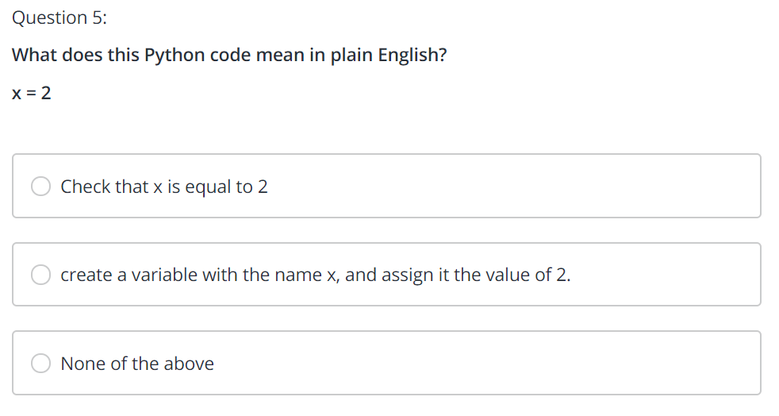

Slide 19
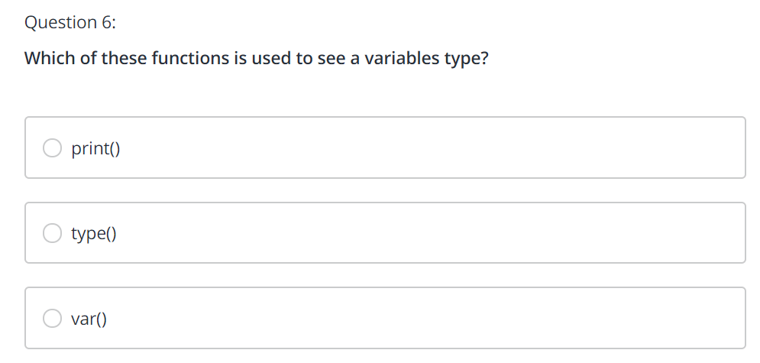

Slide 20
Numbers
Normal operations
>>> 3 + 14
17
>>> 4.5 + 9
13.5
>>> 5 - 4
1
>>> 3 * 4
12
>>> 10 / 5
2.0
>>> 5 % 2
1

Slide 21


Slide 22
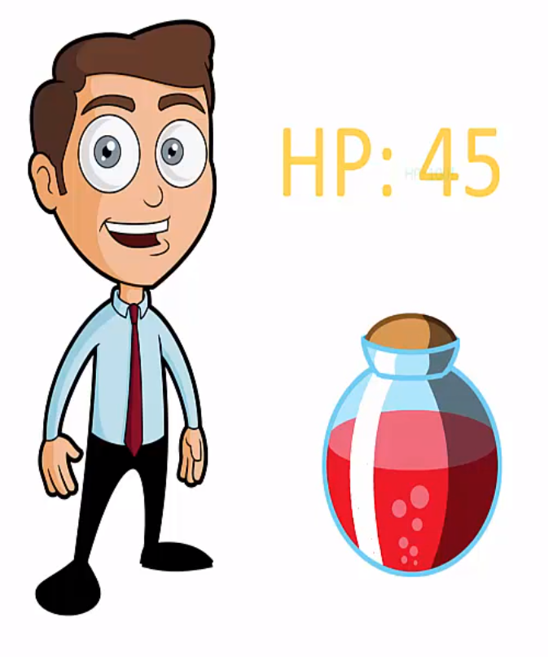

Slide 23


Slide 24
Coding the Game
Create a health variable and assign it a value of 50
Import random
Note that F1 brings you Python help
We will use random.randint(low,high) for random numbers
Generate a potionHealth value from 25 to 50
Now add the potionHealth to health

Slide 25
Difficulty
Add a variable for difficulty.
The following is the current code:
import random
health = 50
potionHealth = random.randint(25,50)
difficulty = 1
health = health + potionHealth
print(health)

Slide 26
Implementing Difficulty
Use difficulty to change the amount of health being added.
health = health + potionHealth / difficulty
Introduces a decimal
81.0
>>>
You can use casting to fix.
health = health + int(potionHealth / difficulty)
for
85
>>>

Slide 27
Changing Difficulty
You can change the difficulty value as follows:
import random
health = 50
potionHealth = random.randint(25,50)
difficulty = 3
health = health + int(potionHealth / difficulty)
print(health)
64
>>>

Slide 28
Python Math
>>> round(2.1)
2
>>> round(2.8)
3
>>>

Slide 29
More Advanced
import math
>>> math.floor(2.8)
2
>>> math.ceil(2.1)
3
>>>
>>> math.pi
3.141592653589793
>>> math.e
2.718281828459045

Slide 30
Trig Functions
Values are in radians
>>> math.sin(1)
0.8414709848078965
>>> math.cos(1)
0.5403023058681398
>>> math.tan(math.pi)
-1.2246467991473532e-16
>>> math.asin(.2)
0.2013579207903308
>>> math.acos(.2)
1.369438406004566
>>> math.atan(.2)
0.19739555984988078

Slide 31
Powers
>>> math.pow(2,3)
8.0
>>> math.pow(5,.5)
2.23606797749979
Or
>>> 2 ** 3
8
>>> 5 ** .5
2.23606797749979

Slide 32
Other
>>> math.exp(2)
7.38905609893065
>>> math.log(math.e)
1.0
>>> math.log2(12)
3.584962500721156
>>> math.log10(12)
1.0791812460476249

Slide 33
Strings
Strings are of type str
>>> print(type("Hello world"))
<class 'str’>
The following is broken:
"John said to me "I will see you later"“
but can be fixed
'John said to me "I will see you later"'

Slide 34
Long Text Strings
The following does not work because of the line breaks
romeo = "Two households, both alike in dignity,
In fair Verona, where we lay our scene,
From ancient grudge break to new mutiny,
Where civil blood makes civil hands unclean.
From forth the fatal loins of these two foes
A pair of star-cross'd lovers take their life;
Whose misadventured piteous overthrows
Do with their death bury their parents' strife.
The fearful passage of their death-mark'd love,
And the continuance of their parents' rage,
Which, but their children's end, nought could remove,
Is now the two hours' traffic of our stage;
The which if you with patient ears attend,
What here shall miss, our toil shall strive to mend.”

Slide 35
Fixing Long Text Strings
The following does work because it has three quote marks
romeo = “""Two households, both alike in dignity,
In fair Verona, where we lay our scene,
From ancient grudge break to new mutiny,
Where civil blood makes civil hands unclean.
From forth the fatal loins of these two foes
A pair of star-cross'd lovers take their life;
Whose misadventured piteous overthrows
Do with their death bury their parents' strife.
The fearful passage of their death-mark'd love,
And the continuance of their parents' rage,
Which, but their children's end, nought could remove,
Is now the two hours' traffic of our stage;
The which if you with patient ears attend,
What here shall miss, our toil shall strive to mend.““"

Slide 36
Writing a Sample Program
Comments begin with #
# ask user for name
# ask user for age
# ask user for city
# ask user what they enjoy
# create output text
# print output to screen

Slide 37
The Program
1. Ask user for their name
name = input('What is your name? ‘)
2. Ask user for their age
age = input('What is your age? ')
ageInt = int(age)

Slide 38
# ask user for name
name = input('What is your name? ')
# ask user for age
age = input('What is your age? ')
ageInt = int(age)
# ask user for city
city = input('What city do you live in? ' )
# ask user what they enjoy
enjoy = input('What do you enjoy doing? ')
# create output text
display = "Hello " + name + ", you are " + age
display = display + " years old and you enjoy " + enjoy + " while living in " + city
# print output to screen
print(display)

Slide 39
Interesting String Facts
>>> someText = "Who dis?"
>>> someText * 3
'Who dis?Who dis?Who dis?’
>>> "="*20
'====================‘

Slide 40
Converting to String
Use the str function to convert non-strings to strings
>>> A = "This is a test "
>>> B = 1
>>> A + B
Traceback (most recent call last):
File "<pyshell#30>", line 1, in <module>
A + B
TypeError: can only concatenate str (not "int") to str
>>> A + str(B)
'This is a test 1'

Slide 41
Better Way to Create Composite Strings
The format function is a more robust way to create composite strings.
>>> A = "This is a test"
>>> B = 1
>>> "{} - {}".format(A,B)
'This is a test - 1’
Or
"{0} - {1}".format(A,B)
'This is a test - 1'

Slide 42
Revamping the Sample Program
Using format is better than the concatenations that were used earlier.
display = "Hello {0}, you are {1} years old and you enjoy {2} while living in {3}".format(name,age,enjoy,city)
Or
display = "Hello {0}, you are {1} years old and you enjoy {2} while living in {3}“
output = display.format(name,age,enjoy,city)

Slide 43
String Methods
>>> myString = "Happy Birthday"
>>> myString.count("a")
2
>>> x = "happy birthday"
>>> x.lower()
'happy birthday'
>>> x.upper()
'HAPPY BIRTHDAY'
>>> x.capitalize()
'Happy birthday’
>>> x.title()
'Happy Birthday'
.upper() and .lower() create copies. Strings are immutable

Slide 44
You can do the following:
x = "this is a test"
x = x.lower()
x = x.upper()

Slide 45
Other Useful Methods
.islower()
.isupper()
.istitle() ← "Happy Birthday"
.isalpha()
.isdigit()
.isalnum()

Slide 46
Finer String Points
>>> x = "happy birthday"
>>> x.index("birthday")
6
Do case insensitive as follows:
>>> x = "happy birthday"
>>> x.lower().index("birthday")
6
No Match
>>> x.index("crap")
Traceback (most recent call last):
File "<pyshell#5>", line 1, in <module>
x.index("crap")
ValueError: substring not found

Slide 47
More Finer Points
>>> x.find("birthday")
6
>>> x.find("crap")
-1
>>> y = "-----happy birthday----"
>>> y.strip("-")
'happy birthday'
>>> y.lstrip("-")
'happy birthday----'
>>> y.rstrip("-")
'-----happy birthday’
>>> z = " happy birthday "
>>> z.strip()
'happy birthday'

Slide 48
More Details
>>> len(x)
14
>>> len(y)
23
>>> len(z)
18
>>> x[0:7]
'happy b'
>>> y[3:6]
'--h'
>>> z[2:9]
'happy b'
>>> a = "happy birthday Chuck Wagon"
>>> a
'happy birthday Chuck Wagon'
>>> a.split(" ",-1)
['happy', 'birthday', 'Chuck', 'Wagon']
>>> a.split()
['happy', 'birthday', 'Chuck', 'Wagon']
>>> a.split(" ")
['happy', 'birthday', 'Chuck', 'Wagon']

Slide 49
Slicing Strings
>>> word = "supercalifragilisticexpalodocious"
>>> word[0]
's’
variableName[start:end:step]
variableName[start:end]
variableName[index]
variableName[start:]
variableName[start::step]
variableName[:7]
variableName[::-1]
variableName[-2]

Slide 50
Slicing – Part 2
using .index() to slice
>>> word[word.index("cali"):word.index("fragi")]
'cali’
>>> word[word.index("docious"):]
'docious’
>>> length = len("fagilistic")
>>> start = word.index("fragilistic")
>>> word[start:start+length+1]
'fragilistic'

Slide 51
More
>>> length = len("fagilistic")
>>> start = word.index("fragilistic")
>>> word[start:start+length+1]
'fragilistic'

Slide 52
Practice Program
# here is a very long word
word = "antidisestablishmentarianism"
# use a slice to take out the word "establishment"
# and store it in the answer variable....
answer = #erase me and enter slice here...

Slide 53
Solution
# here is a very long word
word = "antidisestablishmentarianism"
# use a slice to take out the word "establishment"
partialWord = "establishment"
establishmentIndex = word.index(partialWord)
establishWord = word[establishmentIndex:establishmentIndex+len(partialWord)]
# and store it in the answer variable....
answer = establishWord

Slide 54
Another Sample Program
#get user email address
#slicer out user name
#slice domain name
# format message
#display output message

Slide 55
Slicer Program
#get user email address
email = input("What is your email address? " ).strip()
#slice out user name
user = email[:email.index("@")]
#slice out domain name
domain = email[email.index("@")+1:]

Slide 56
Continued
# format message
output = "Your username is {} and your domain name is {}".format(user,domain)
#display output message
print(output)

